Slide 1
TDWI St. Louis
Sept 4, 2015 Data Governance & MDM
@tdwistl | #tdwistl | tdwistl@gmail.com

Slide 2
Agenda
8:00 - 8:30 | Registration & Networking
8:30 - 9:00 | Introductions & Sponsors
9:00 - 10:00 | 5 Important ‘Ground Hog Day’ Scenarios in Data Governance and MDM Len Silverston, Universal Data Models, LLC
10:00 - 10:30 | Break
10:30 - 11:30 | SUPPLY CHAIN – Master Data Management Terry Brown, Senior Director Supply Chain Systems, VF
11:30 - 12:00 | Survey, Raffle, & Closing

Slide 3
Board Members
Rob Villareal | President
Ryan Murphy | Vice President
Micah Katcher | Publicity
Doug Graham | Publicity
Brian Zielinski | Membership
Drew Marco | Sponsorship
Michael Perlmutter | Sponsorship
Michael Wenger Paul Boal Selina Tourjee | Secretary At Large At Large

Slide 4


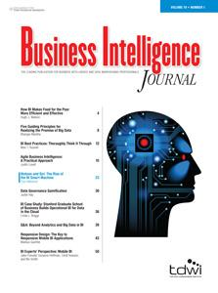


TDWI Membership

Slide 5
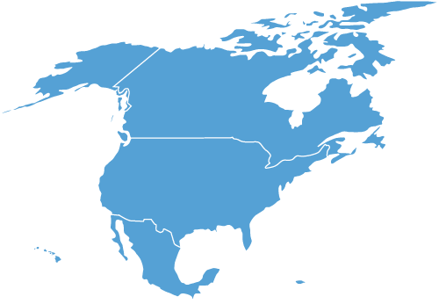
2015-2016
Conference
Schedule
Conference
Chicago
May 8-13, 2016
Business Analytics
San Francisco
November 2-5, 2015
Dimensional Modeling
New York
Oct 5-8, 2015
Conference
San Diego
Sept 20-25, 2015
Conference
Las Vegas
Jan 31-Feb 5, 2016
Enterprise Data Management
Atlanta
October 12-15, 2015
Conference
Orlando
Dec 6-11, 2015
TDWI Conferences
Notes:
September 20–25, 2015
Leading in a Data-Driven Organization
Data Analytics
Big Data
Data Visualization
Data Modeling and Management
Data Warehousing and BI
Tools and Technologies
--------------
December 2015
TDWI Conference in Orlando
December 6–11, 2015
BI & Analytics Essentials
BI & Analytics Leadership
BI & Analytics Directions
Data Warehousing Directions
Data Analytics & Visualization
Big Data
Data Modeling & Management
Tools & Technologies

Slide 6
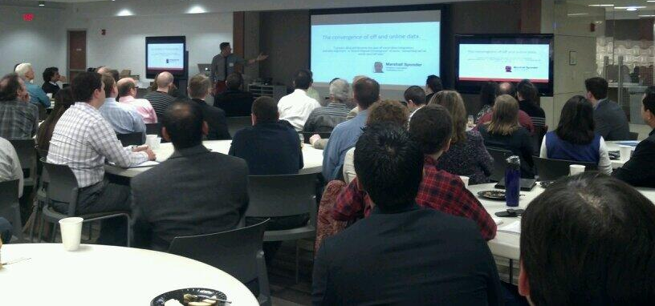
Ask your neighbor to learn more

Slide 7
2015 St. Louis Meetings
March 6 - Business Intelligence & Business
June 5 – New Technologies
September 4 - Data Governance & MDM
December 4 - Data Science & Predictive Analytics

Slide 8






Chapter Sponsors

Slide 9
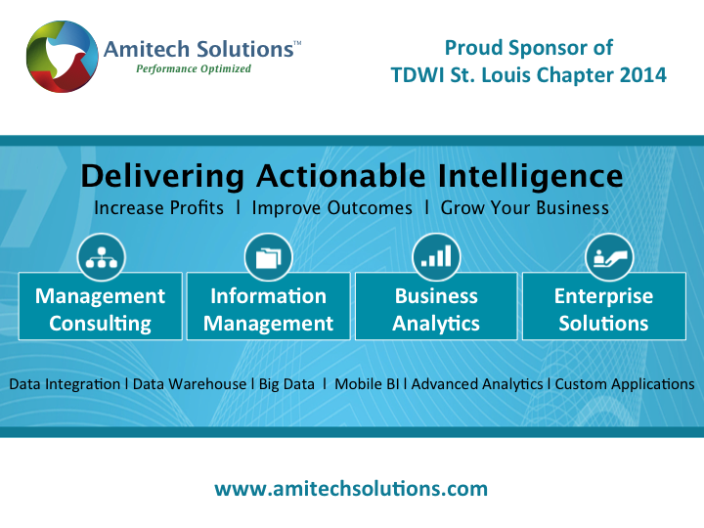

Slide 10
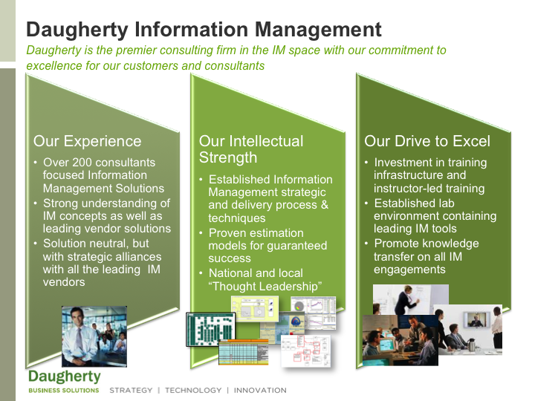

Slide 11






IBM Information Integration and Governance Capabilities
Information Integration and Governance
Information Integration
Data
Quality
Master & Reference Data
Data Lifecycle Management
Privacy & Security
Extract, Transform, Load
Replicate
Federate
Standardize
Validate
Verify
Enrich
Match
Master multiple domains
Manage registry or transaction hub
Collaboratively author
Govern master data
Archive databases
Manage test data
Activity monitoring
Masking
Encryption
Redaction
Metadata, Business Glossary and Policy Management and Entity Analytics
Automated data discovery
Enterprise metadata repository
Business terminology defined in business glossary
Define, share and execute information governance policies
Information Governance project blueprints
Incremental context accumulation

Slide 12
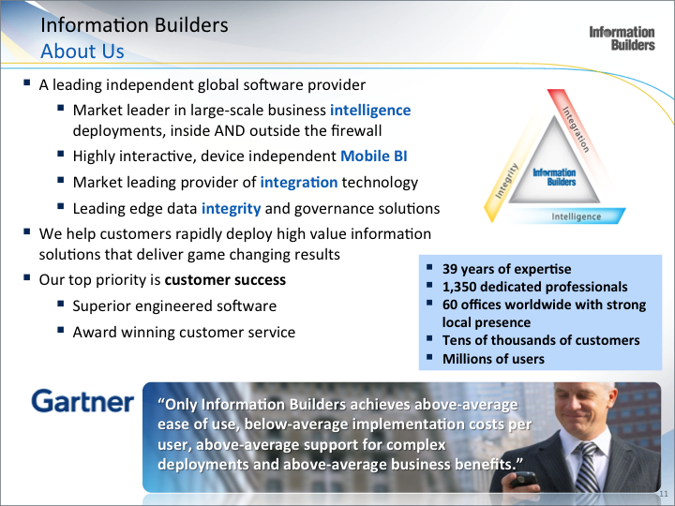

Slide 13
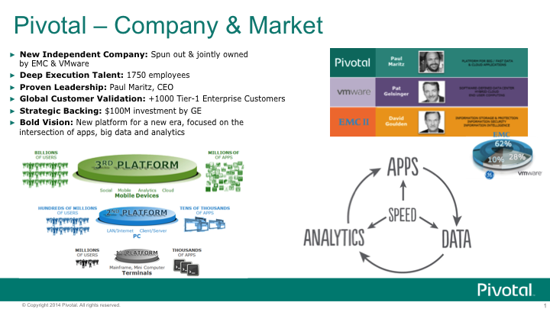

Slide 14
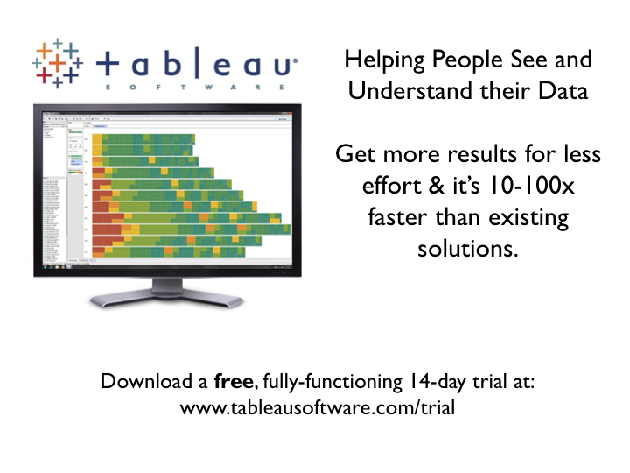

Answer questions as fast
as you can think of them
with Tableau.
Get more results for less effort & it’s 10-100x faster than existing solutions.
Get a free, fully-functioning 14-day trial at:
www.tableau.com/trial

Slide 15


5 Important ‘Ground Hog Day’ Scenarios in Data Governance and MDM
And How to Address Them!
For TDWI St. Louis, Sept 4th, 2015
By Len Silverston, Universal Data Models, LLC

Slide 16

Inevitable Scenarios
Data ownership
Trouble getting buy-in?
Politics!
“I am right”
Enterprise versus project
Notes:
I am privileged to be able to consult and help many different data governance and data management efforts and sometimes I feel like I am in the movie 'Ground Hog Day', repeating the same type of day with different organizations! The same common scenarios show up. Some of the most common scenarios that I have witnessed are:
Data ownership - people often view the data on their project/application as 'my data' as opposed to this data is owned by our whole enterprise. For example, a sales person may view their customer and account data, as 'my data' and may be thinking "that is nice that you are integrating customer information in the data warehouse, but I will keep 'my data' on my own machine". I refer to this 'data mining' or 'data "mine"ing'!
“I am right” - I worked on one data management effort where there were four expert data modelers and each modeler had very strong opinions about the “right” way to model a construct. One modeler even went so far as to say that the other modelers way would result in a “terrible design” and the project was doomed since we didn’t choose his way. If in data integration efforts, we try to push the one “right” solution or definition, then we are at risk of looking at things narrowly, creating conflict, increasing costs, and failed solutions. If instead we are open to various perspectives along with their pros and cons realizing that usually there is not one 'right' way, then we can usually make more progress in gaining acceptance.
Enterprise versus project - There are often two viewpoints: 1) the enterprise wide viewpoint of integrating data, for example in implementing an enterprise data governance or data management program 2) a project perspective of I need data for this specific effort. I have been involved in this scenario so many times and this often leads to conflict. Conflict is not bad in itself, however, how we handle conflict when it occurs, it extremely important for success.
Trouble getting buy-in? Especially for enterprise-wide data management efforts, there is often trouble getting people to fully buy-in to these programs and there is sometimes a perspective that these efforts are not as practical as projects that are designed to implement a very specific system.
Politics! When we asked the question to many organizations, 'Why did your data governance or data management effort fail?" the most common answer was 'politics'. And when we asked why efforts were successful, human factors were most often mentioned as the key.

Slide 17


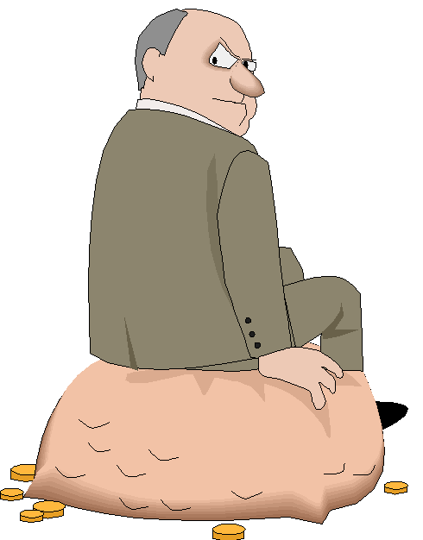
Scenario #1 – Data Ownership
“Mine”

Slide 18

1. Understand Motivations
Motivations
Motivations

Slide 19
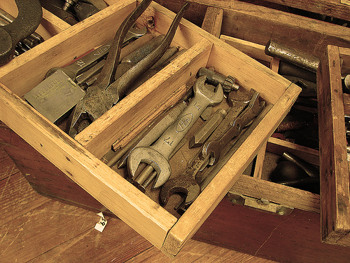
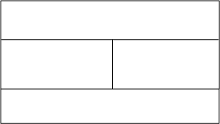
Motivational Model - Sponsorship Map
Project/Program
Name and title of person or sponsor
What does this person want?
How will your project/program help them?
How will your project/program be an obstacle?
What do we want from this person?
BE SPECIFIC!

Slide 20
Four Basic Wants
Control
Approval
Security
Separateness
From “The Sedona Method “ by Hale Dwoskin
Underneath - Caring

Slide 21
Values Determination
Space
Time
Energy
Money
Organized
Reliable
Goals
Inspires
Visualize and realize
External dialogue
Internal dialogue
Think
Learn
From Dr. John F. Demartini’s Value determination process https://drdemartini.com/value_determination

Slide 22

Scenario #2 – Trouble Getting Buy In?
We are establishing a data governance and MDM program to ensure accountability, synchronization and integration of our enterprise-wide data.
????????

Slide 23


2. Clear, Compelling, Common, Concise Mission and Vision
Mission
Vision

Slide 24

What is the mission of your DG and/or MDM org?
What is your enterprise’s mission?
What is your personal mission?
How do they relate?

Slide 25

Scenario #3 – Politics
I would be glad to share and integrate our data with the enterprise wide MDM and follow data governance procedures.

Slide 26

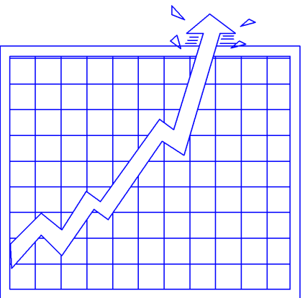
3. Develop Trust
Character
  Integrity
  Intent
  Vulnerability/openness
Competence
  Capabilities
  Results
From “The Speed Of Trust” By Stephen M. R. Covey (modified – added vulnerability/openness)
Notes:
In “The Speed Of Trust”, the author, Stephen M. R. Covey (son of Stephen R. Covey who wrote “the Seven Habits of Highly Effective People”, says that “trust is a function of two things: character and competence. Character includes your integrity, your motive, your intent with people. Competence includes your capabilities, your skills, your results, your track record.” He further breaks down Character into Integrity and Intent and Competence into Capabilities and Results, stating that these are the 4 core, foundational, elements of trust.
Character is broken down into integrity and intent.
Integrity is about doing what you say and saying what you do. It is about keeping your word and commitments.
Intent is about your motives and whether your motives are mostly self indulgent or about service and helping others.
Competence is broken down into capabilities and results.
Capabilities are about the talents, attitudes, skills, knowledge, and style.
Results are about your track record of what you have produced and what outcomes you have had.
How would you rate yourself in each of these areas?
How would others rate you in each of these areas?

Slide 27

Scenario #4 – ‘I am right’
“I hear you regarding
your approach to data governance and MDM,
but my way is the right way!”

Slide 28




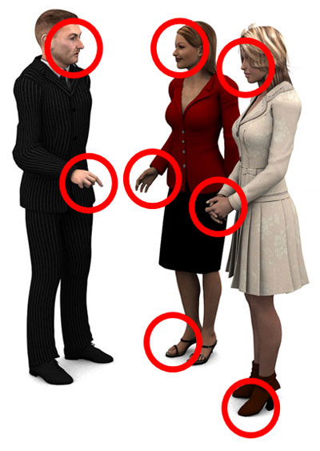


To Listen, ACCEPT
4. Effective Communication – To Listen, Accept
(A) ware, attention, alert
(C) are
(C) onfirm, check
(E) mpathize
(P) urpose
(T) otally (with all senses)
Listen

Slide 29





4. Effective Communication – To Express, SHARE
(S) traight
Crystal Clear
(H) elp
(A) udience
(R) eason
(E) ngage

Slide 30
Scenario #5 – Enterprise Vs. Project
Director of Enterprise Data Governance or MDM
“We are excited to work together with you on this project helping you to use enterprise wide, integrated data and standardized definitions for your project so that the data is of high quality and standardized.
Project Manager:
We completely support enterprise-wide data integration, governance and MDM. However, we have very tight deadlines and budgets for delivering this project, so we’ll work together with you as long as you don’t impact our deadline dates, tasks, resources, or budgets in any way.”
WHERE WOULD YOU TAKE THIS CONVERSATION?

Slide 31
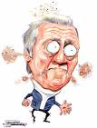

5. Manage Conflict Effectively

Slide 32
Handling Conflict
Step 1. Don’t react
Stay objective
Step 2. Disarm
Step to their side
Step 3. Change the game
Don’t reject ….Reframe (holistic) (common goal)
Step 4. Make it easy to say yes
Build a golden bridge (truly win-win)
Step 5. Bring them to their senses, not their knees
(using power, not force)
From “Getting Past No: Negotiating with Difficult People” By William Ury

Slide 33
Don’t React
Step 1. Don’t react
Feelings/Thoughts
Event
Emotional
Physical
Stories
Mess
Reaction
Freeze
Flight
Fight

Slide 34
Respond
Step 1. Don’t react
Feelings/Thoughts
Event
Emotional,
Physical,
Stories
Response
Data
Stop – observe.
Data?
Questions?
Intelligent Actions

Slide 35
1. ME
2. YOU
3. US

Slide 36





Data ‘Mine’ing
Buy in?
SUMMARY
Motivations
Politics
Enterprise Vs Project
CONFLICT MANAGEMENT
TRUST
I am right
COMMUNICATION

Slide 37

What Will You Do With This?

Slide 38

Creative Commons Image Attributions
Much thanks to those who provided the creative common images in this presentation. Thanks for:
  Toolkit https://www.flickr.com/photos/goodmoldings/4008546255/sizes/o/ © All rights reserved by Good Millwork
  Sky https://www.flickr.com/photos/cubagallery/9679210392 © All rights reserved by ►CubaGallery

Slide 39
Questions or More Info?
www.universaldatamodels.com
lsilverston@univdata.com
len@zenwithlen.com
Twitter: @lensilverston

Slide 40
Break
Come back at 10:30

Slide 41
POWERFUL BRANDS. POWERFUL PLATFORMS. ONE VF.
SUPPLY CHAIN – Master Data Management
SEPTEMBER 4, 2015

Slide 42

VF Corporation – Overview
No. 248
Fortune 500
Powerful Brands.
Powerful Platforms.
ONE VF.
ORGANIZED IN1899
116 years old
59,000
global
associates
17 X 17
PLAN
is guiding our actions
$
12.3B
Diverse portfolio
of lifestyle apparel, footwear and accessories
revenue
learn from
the past, live
in the future
CULTURE
more than
30
brands
ABOUT
revenue
outside
Americas
40%
Notes:
Our ability to transform, our ability to fuel and sustain our momentum and our One VF approach to business has brought us to this snapshot of VF today.
I’ve said it before and I’ll say it again, we are really proud of this.
On this slide we see iconic brands, growing brands, logos that represent brands that are leaders in their space, brands that have prospered and those that have struggled from time to time but always emerged stronger.
These are brands we’ve grown, we’ve acquired and brands we’ve transformed. I don’t know a CEO in the world who doesn’t admire the powerful brands we have.
And, we have scale; we have staying power; we have diversity; we have talented associates around the world and we have a plan to guide our growth.
The VF culture is special – it didn’t happen overnight. We have a 116 year legacy – a culture of learning from the past and living in the future.
I like to say that we all are blessed to stand on the shoulders of those who came before us – and we can’t forget that someday others are going to stand on our shoulders.
We have continuing obligation to provide a strong platform on which they can stand and build the VF of tomorrow.

Slide 43
VF Corporation – Historic Momentum
Revenue ($ millions)
Gross Margin %
Share Price (split adjusted)
Gross Margin
+1,000 bps
Share Price
+53%
Gross Margin
+350 bps
Share Price
+56%
Gross Margin
+230 bps
Share Price
+253%
Revenue
Flat% CAGR
Revenue
+6% CAGR
Revenue
+11% CAGR
Notes:
In the early part of our discussion today, I’m setting the table so that we are all aligned around the fact that VF has terrific business momentum heading into the quarters and years ahead. Perhaps this is the pay-off slide to make the point.
This is momentum!
The three measures are simple, but oh so important: revenue in blue, gross margin in green and our share price represented in the black line.
What fueled that momentum? Acquisitions. Divestitures, including our name sake Vanity Fair intimates. A sharpened focus on improving our gross margin, which ties to so many variables. We shaped our portfolio. We invested in growing brands.
We sharpened our customer and consumer focus, while driving innovation. We saw the value of across VF collaboration and leveraged it. We set plans and we achieved and surpassed them. We built our international business. In 2007 we even sold our namesake Vanity Fair Intimates.
As we look to fueling our momentum, we need to look at some of the same growth levers that we leveraged during the past 15 years – we have choices to make and we will make the right choices, sometimes difficult ones, to fuel our momentum.

Slide 44
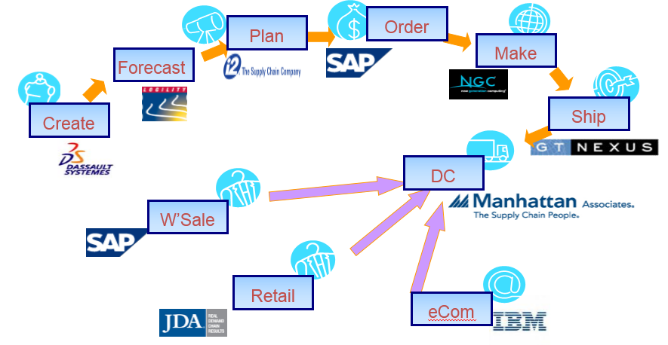

Supply Chain Systems
Sourcing balance
  25% Owned Manufacturing
  35% Third Way
  40% Sourced
Global Business Technology provides a powerful platform
Proven technology partnerships
Diverse application strategies with best in class performance
Supply Chain Systems support production through fulfillment, all systems needed to meet the dynamics business in a complex apparel and footwear world.

Slide 45
What is Master Data Management, and Why?
What is MDM?
Why does MDM matter?
Master Data refers to critical non-transactional data entities such as product, customer, supplier, location, materials, etc.
Master Data is typically managed by business users and may include reference data such as hierarchies and lookup codes
MDM (Master Data Management) is a set of processes, governance, policies, standards and tools that consistently define and manage the master data of an organization
MDM is about …
Establishing a single source of truth for master data
Syndicating or cross-referencing master data across heterogeneous systems for consistency and quality
It’s more of processes. Technology is only an enabler
Enterprises struggle with fragmented and inconsistent master data, leading to ill-informed decisions
MDM addresses the Data Quality problem
  Data Errors - 30% of data in systems is wrong
  Productivity Loss – 25 minutes manual cleansing / SKU / year
  Delayed Time To Market – 4 weeks to introduce new products
  Invoice Deductions – 43% of invoices result in deductions
  Lost sales – Up to 3.5% of sales per year
  Higher costs – procurement, transportation, warehousing, compliance, digital asset management, print publishing
Helps reduce costs, improve decisions, and increase sales

Slide 46
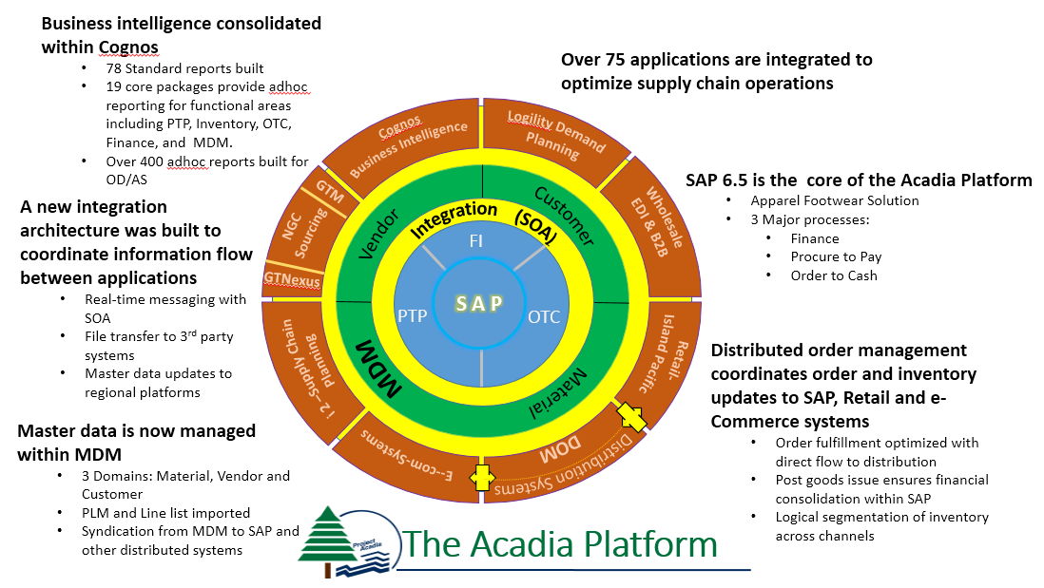
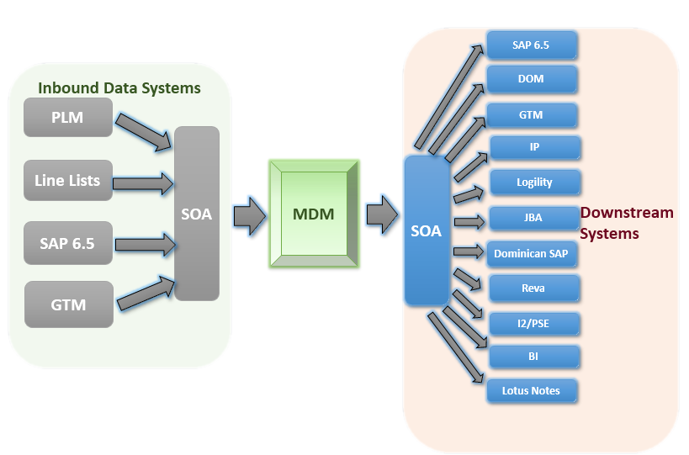
Why MDM, Why Now?
VF Acquired Timberland in 2011
Need to consolidated business operations onto a common platform
Outdoor and Action Sports is VF’s fastest growing coalition
Upgrade to SAP entailed complexity reduction, driving more functionality to supporting applications
It was time for centralized Master Data !

Slide 47
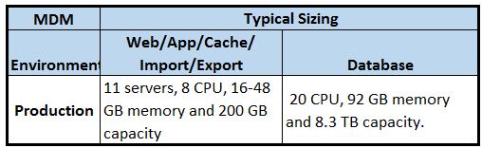
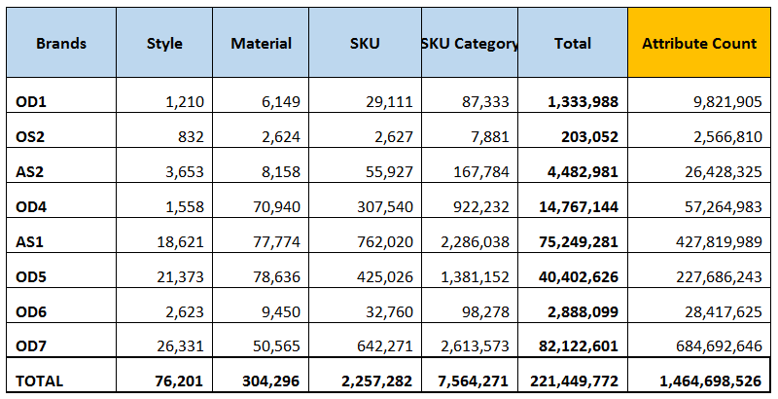
What Did We Implement?
The Acadia project drove MDM requirements and timeline, 3.5 year project encompassing 2 major go-lives: Timberland, Outdoor and Action Sports
Attribute values and business rules were derived from the SAP AFS platform and existing transactional systems.
MDM’s scope included 3 domains: Vendor, Customer and Material
MDM Syndicates data through SOA integration to 11 core applications (global).
And, what we Learned…
Not all data is Master Data. We removed Product Informational Records (PIR) relating material to sourcing to cost
Highly normalized data is difficult for reporting in volume. We built a cache based Audit Report
Data quality is critical across applications. We are building an Operational Data Store.
The impact of Organizational Change by introducing MDM into the business cycle.
Entity definition, # attributes:
  Material 298
  Customer 196
  Vendor 143

Slide 48
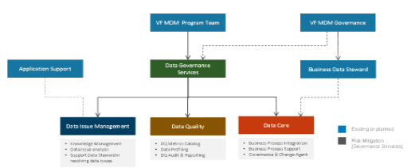
Master Data Governance During Acadia
Current State
Desired State
  No enterprise-wide approach to master data and its governance
  Applications in place today (e.g. SAP, DOM) address critical issues in the business, but lack an enterprise-wide approach to master data
  Fragmented roles and responsibilities across the organization relative to ownership of master data
  Lack of clarity in data and attribute definitions, processes, and communications regarding the maintenance and utilization of master data
  Implement a comprehensive governance framework to deliver improved enterprise data management and drive business benefits
  Align data governance initiatives and strategic projects
  Provide governance on key enterprise master data to improve data quality across the enterprise without creating a regulatory/governance bottleneck
  Align key stakeholder groups
  Build a consistent approach to defining, managing, and maintaining quality enterprise master data
Lack of formal business driven Master Data Governance:
Business risk : Data feeding from MDM to Syndicate Systems must be maintained
To mitigate risks associated with Use of MDM, Ensuring Data Quality, and Resolving Data Issues
Allow on going data changes to support business needs
Interim team

Slide 49
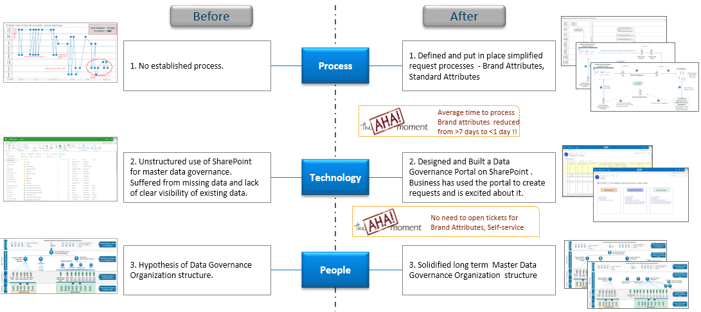
Master Data Governance, Pilot
We conducted a pilot initiatives with our business to determine the ‘right’ size of Master Data Governance within VF
We delivered a working model, which is in place today
We kept the technology footprint light.

Slide 50
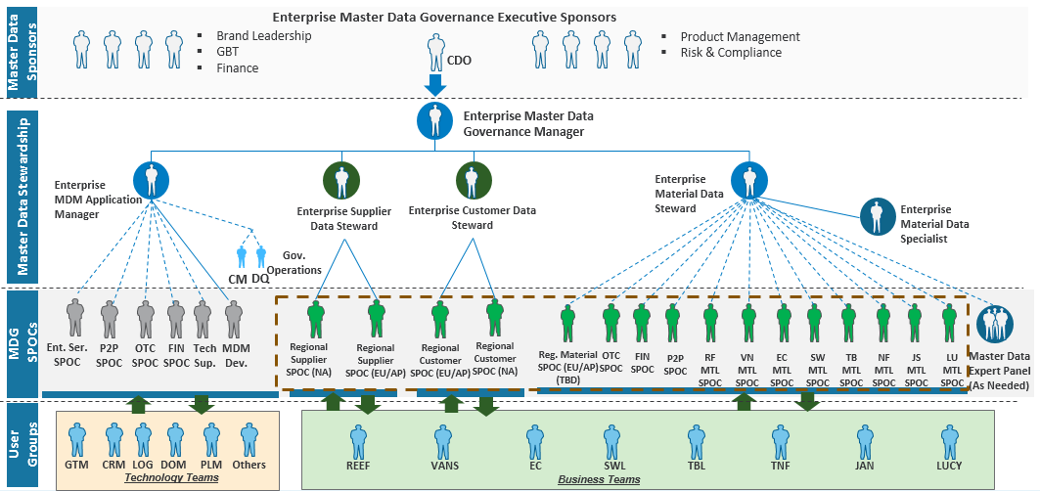
Master Data Governance Organization
We are in process of approving a new Business Organization:
This leverages existing business members within the brands
Adds 4 new roles for Governance Manager, 2 stewards and a material specialist
This expands globally as Master Data is rolled out to other regions
Eventually will lead to a Chief Data Officer with ownership over Data Governance

Slide 51

Questions?
The Master Data journey has begun at VF
Master Data Governance will be our business user for MDM
This is a large Organizational Change initiative, and was a risk in doing MDM, and continues to be a challenge
We are still relatively low in the maturity curve

Slide 52
Survey
Please give us feedback. You could win a book!
Based on this event, how likely is it that you would recommend future TDWI chapter meetings to a colleague?
0 1 2 3 4 5 6 7 8 9 10

Slide 53


Get Connected
@tdwistl
#tdwistl
tdwistl@gmail.com

Slide 54

Giveaways

Slide 55
Closing
Thank You!
Speakers Board
Attendees
Volunteers Members

